Slide 1

PREDICTION OF MECHANICAL PROPERTIES OF STEEL USING REGRESSION ALGORITHMS OF MACHINE LEARNING
DESIGN CREDIT PROJECT

Slide 2

DELIVERABLES OF THE PROJECT
To implement the MACHINE LEARNING MODEL on different alloy composition of steel to predict mechanical properties of the system.
To implement different machine learning models and tuning their hyperparameters to obtain the best model and prediction.

Slide 3
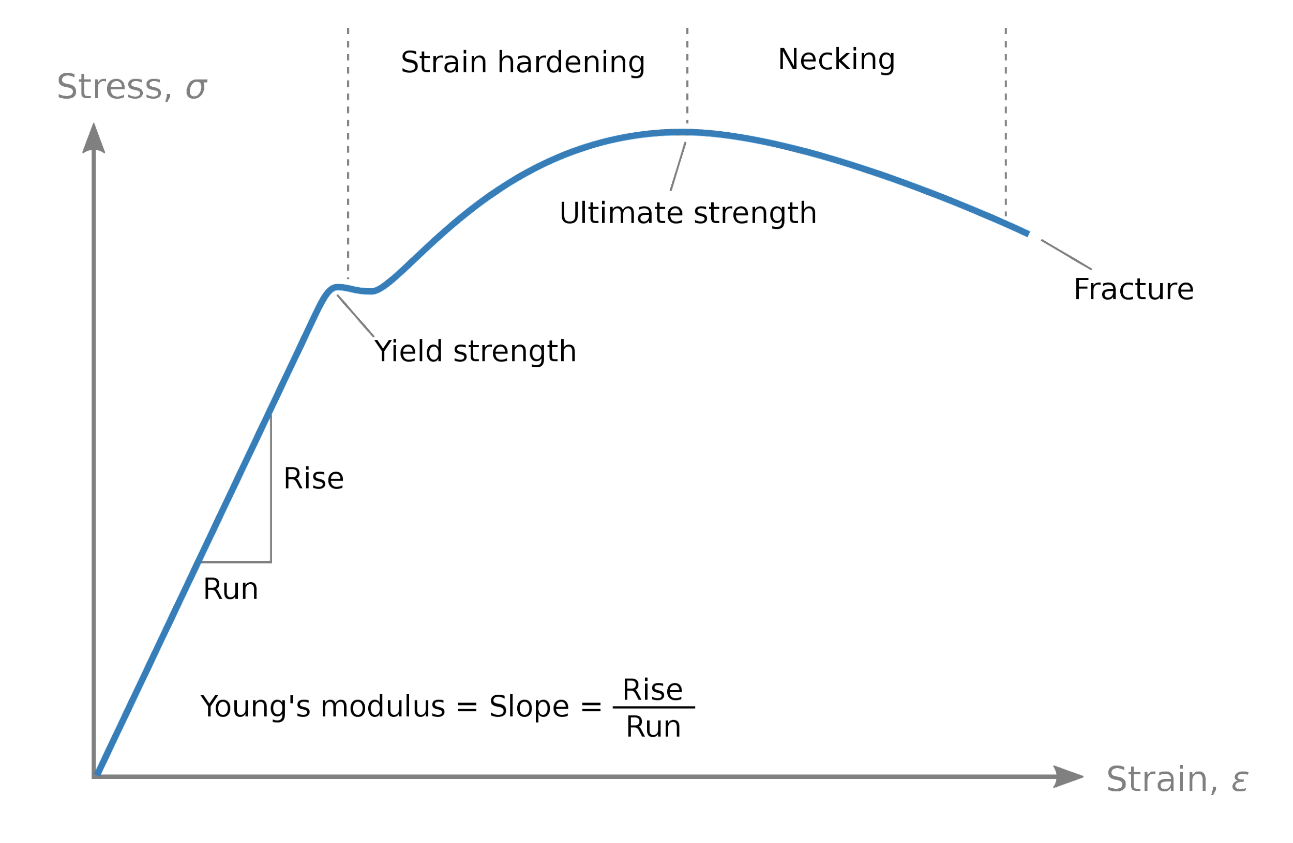
INTRODUCTION
The mechanical properties of a material affect how it behaves as it is loaded.
The strength of the material determines the stresses that it can withstand before it fails.
There are a lot of parameters to affect mechanical properties such as microstructure, heat treatment, process method, composition etc.
Ref: https://upload.wikimedia.org/wikipedia/commons/thumb/c/c1/Stress_strain_ductile.svg/473px-Stress_strain_ductile.svg.png

Slide 4
INTRODUCTION
The main goal of the project is to implement a ML model which accurately predicts the mechanical properties of a material.
The mechanical properties basically include tensile strength, yield strength, elongation is what we need to predict accurately with the help of some of the known regression ML models.

Slide 5
BASIC STEPS TO TRAIN A MODEL
Data Preprocessing
Correlating Parameters
Model Selection
Hyperparameter Tuning
Training with best parameters
Evaluation

Slide 6
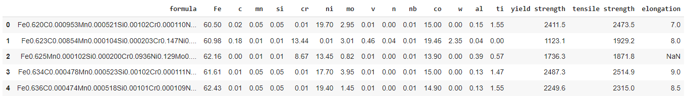
DATASET
Dataset Description:
The obtained data set can be accessed from the following link :
https://drive.google.com/uc?id=1yCnldMkRuXt-NyI5qETfQbWC9yTZYvo7
Colab file link can be accessed from : https://colab.research.google.com/drive/1QxX0Z6NiOpcorZjC7fXxfKuW2DHwjU1q#scrollTo=ARuoA2nM6bZq

Slide 7
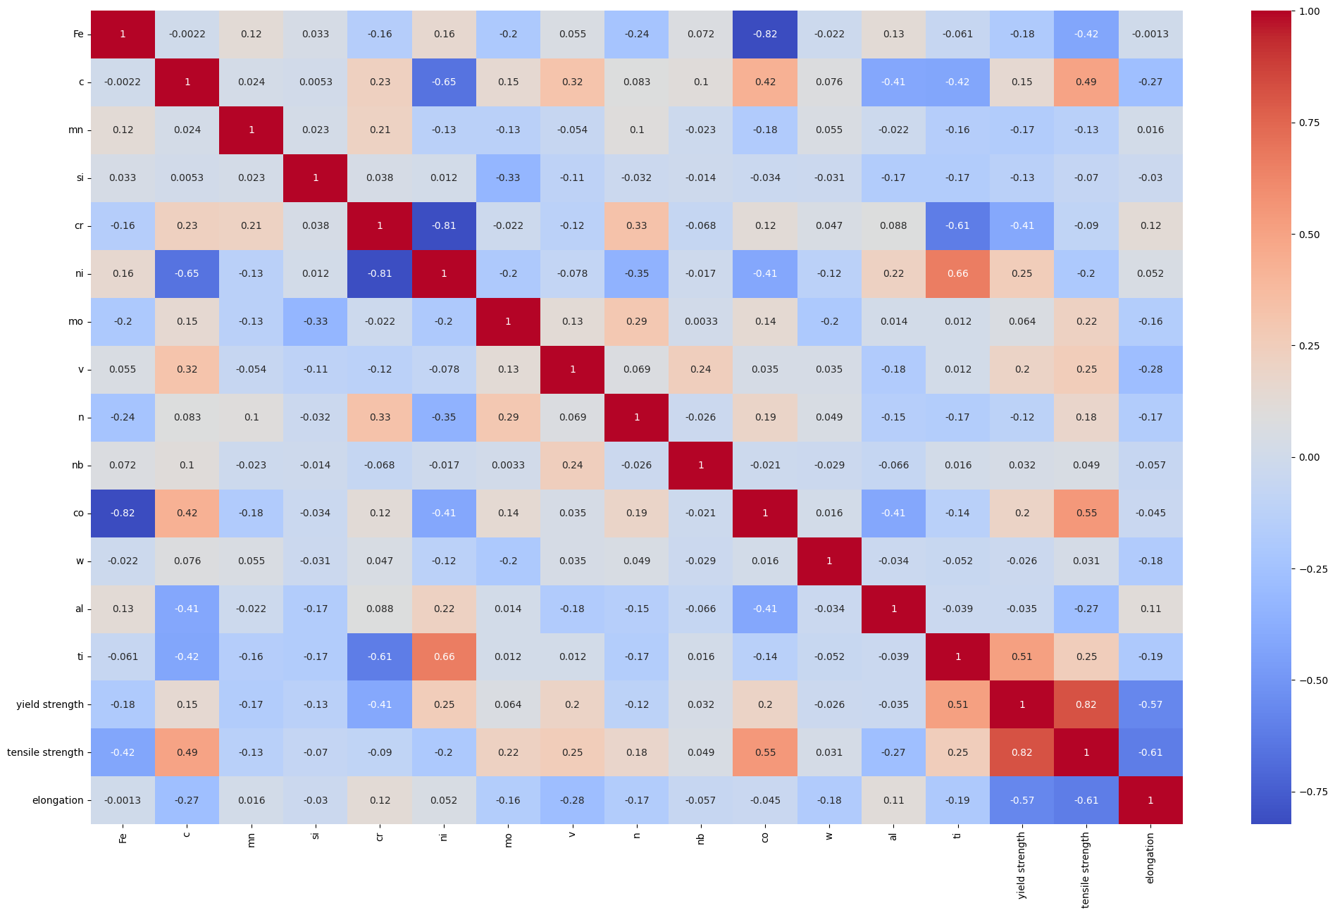
CORRELATION MATRIX

Slide 8
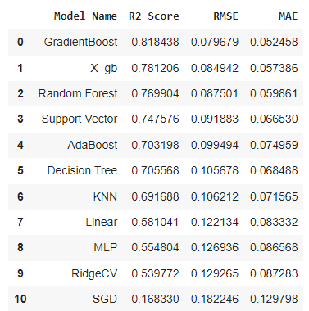
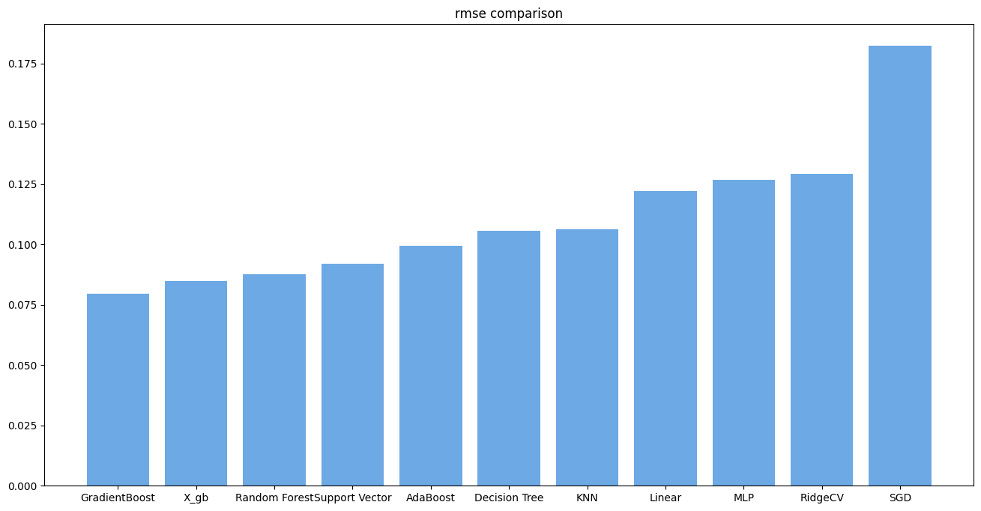
MODEL SELECTION
After preprocessing of data different models are applied with default parameters and obtained the following results:

Slide 9
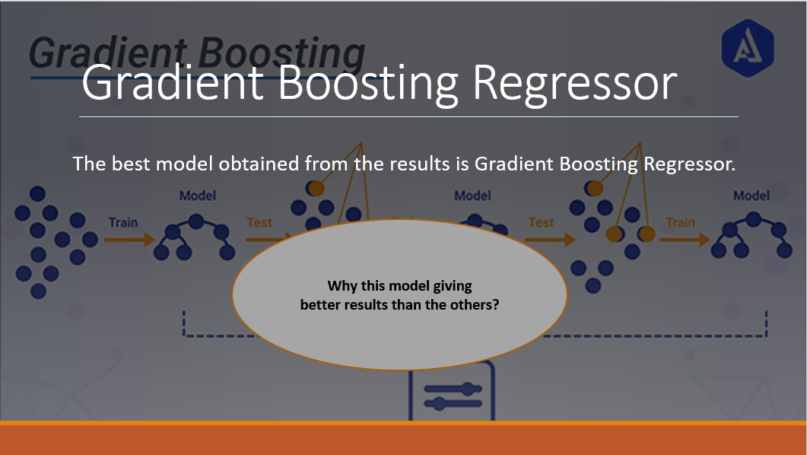

Slide 10
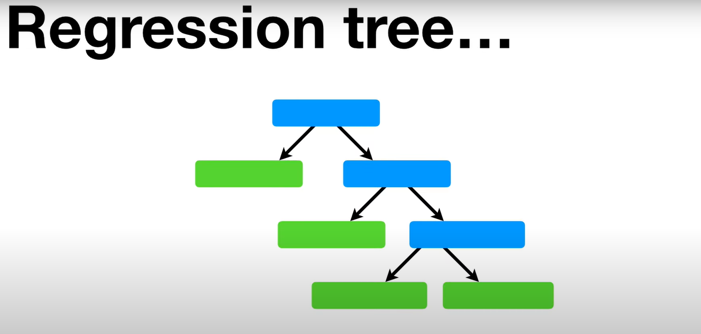

Slide 11
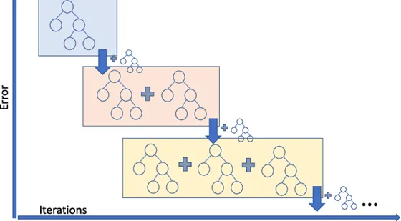
GRADIENT BOOSTING REGRESSION
Gradient boosting is a type of boosting algorithm. It relies on the intuition that the best possible next model, when combined with previous models, minimizes the overall prediction error.
The key idea is to set the target outcomes for this next model in order to minimize the error.
Basically, Gradient Boosting involves three elements:
1. A loss function to be optimized.
2. A weak learner to make predictions.
3. An additive model to add weak learners to minimize the loss function.
Ref: https://medium.com/analytics-vidhya/what-is-gradient-boosting-how-is-it-different-from-ada-boost-2d5ff5767cb2

Slide 12
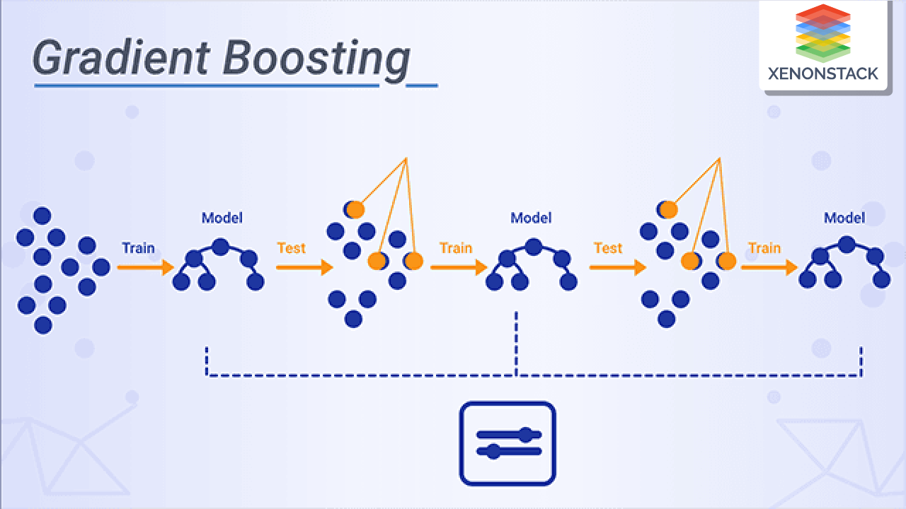
GRADIENT BOOSTING REGRESSION
Steps Involved in Gradient Boosting Regression:
Construct a base tree with single root node. It is the initial guess for all the samples.
Build a tree from errors of the previous tree.
Scale the tree by learning rate (value between 0 and 1). This learning rate determines the contribution of the tree in the prediction
Combine the new tree with all the previous trees to predict the result and repeat step 2 until maximum number of trees is achieved or until the new trees don't improve the fit.
The final prediction model is the combination of all the trees.
Ref: https://www.xenonstack.com/hubfs/gradient-boosting.png

Slide 13



TUNING THE HYPER-PARAMETERS
Tree-Specific Parameters : These affect each individual tree in the model.
Ex. min_sample_split, max_leaf_nodes
•Boosting Parameters : These affect the boosting operation in the model.
Ex. learning rate, n_estimators, subsample
•Miscellaneous Parameters : Other parameters for overall functioning.
Ex. loss, criterion

Slide 14
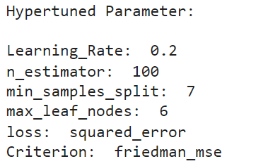
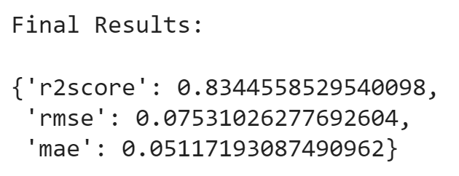
RESULTS AFTER HYPERTUNING
Parameters giving best results:
Final Results from hyper-tuned model:

Slide 15
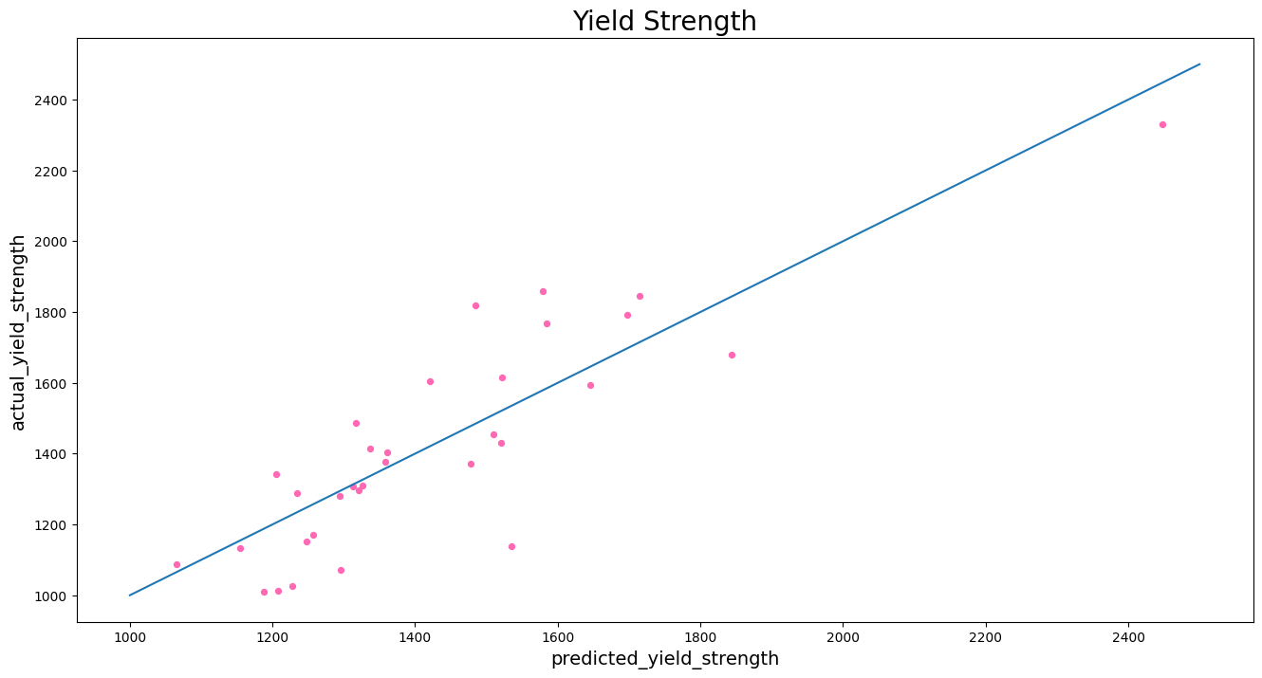
RESULTS OBTAINED

Slide 16
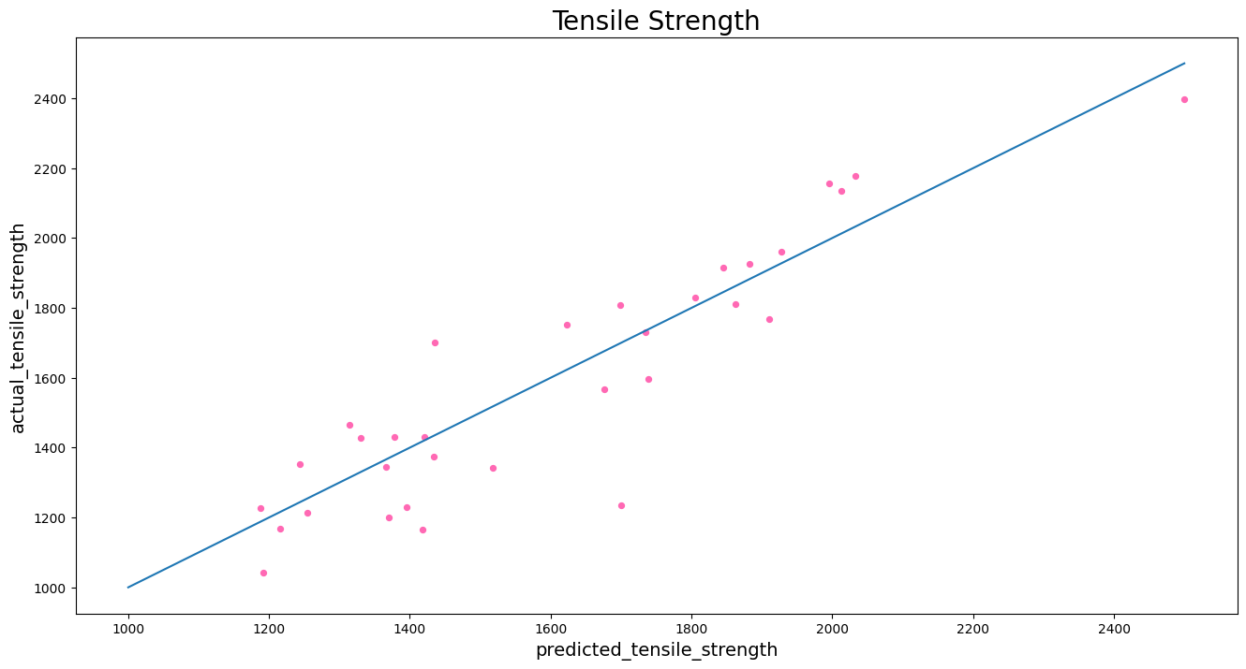
RESULTS OBTAINED

Slide 17
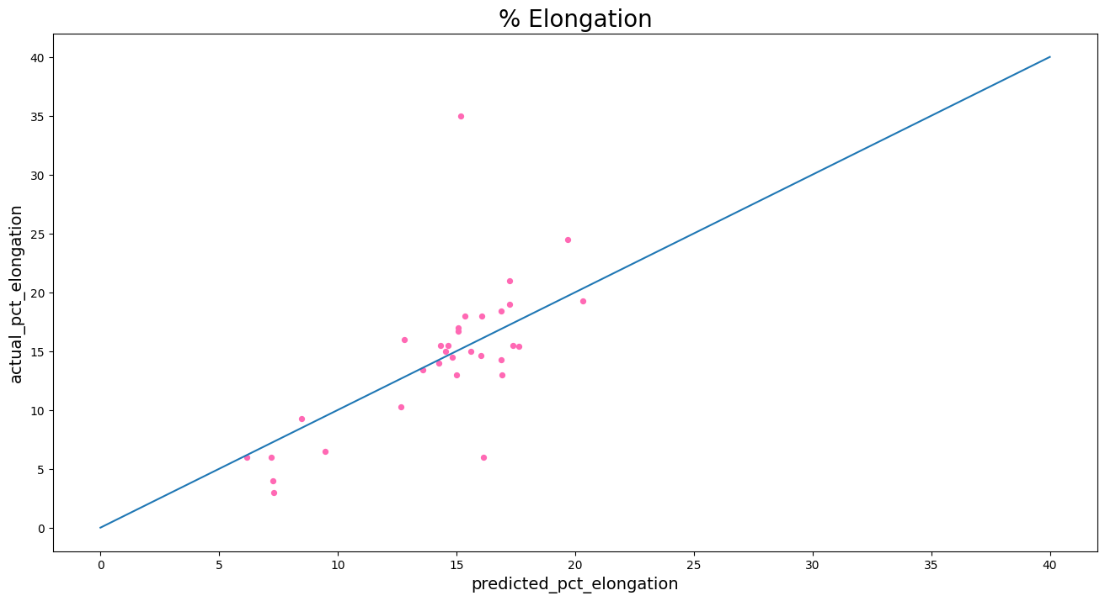
RESULTS OBTAINED

Slide 18

THANK YOU
PRESENTED BY:
YASH JANGIR (B20MT051)
PROJECT SUPERVISOR:
DR. NITIN KUMAR SHARMA
PROJECT MENTOR:
NAVRATAN PANWAR

